Slide 1


CONSULTANCY
MANUFACTURING
EXECUTION SYSTEM OF
MACHINE PRODUCTION INDUSTRY
Created By: PRITIKAA.S
Mentor: Mrs.M.Dhivya
CSE (III YEAR)
211422104356

Slide 2

COMPANY NAME: B.R.J.PRECISION
ADDRESS: DP 115, Ambattur
Industrial Estate,
Chennai-600058.
CEO: R.SRI.HARIHARAN
become

Slide 3
ABSTRACT
Internet has converted a world into a global village. With the popularization of internet, online import and export has become a new and unique trend.
From Machine to electronics, all the things are available on internet. Keeping up this trend, a need for the store is felt because it can enhance the existing system even more.
Consumers do not even need to go to a local store anymore; they can buy each and everything by just sitting in a home at anytime. It is fast, simple, and flexible.
The Import and Export is based on business model. The consumer is provided with the facility of registering, signing in, viewing and ordering the items and secured online transaction.
The consumers may give feedbacks and comments regarding each and every product as well. HTML/CSS, JAVASCRIPT and JAVA are used to build the basic framework of web pages.
MySQL is used for storing information about the consumer and vendors (sellers). Keywords: Import and Export store, e-commerce, shopping cart, web store.

Slide 4
INTRODUCTION
The growing importance of retailing has led several retailer groups to offer their products through multiple channels.
In the Machinery retailing industry, due to the prevalence of digital technology and e-commerce, multiple companies have added an online channel to complement their traditional/offline in-store portfolio of offerings.
Some of the biggest challenges Machinery retailers face is that of order fulfilment and last minute delivery, especially while offering customers a seamless service experience
The issues retailers have to deal with include where orders should be fulfilled , what logistics solutions should be adopted in the last minute delivery (e.g., customer pick-up vs attended or unattended delivery at home, workplace or at a dedicated drop zone), coping with the perishable nature of items and their different handling requirements, the size of the shopping Machinery the range of product offerings.

Slide 5
EXISTING SYSTEM
In this existing system the popularization of internet has encouraged E-commerce as well. E-commerce (Electronic Commerce) is nothing but the selling or buying of the goods and services online.
It has not only replaced the traditional way of store but also provided the comfort and ease to shop from your desk.
Consumers don’t have to go to stores during restricted timings; they can buy almost everything at anytime from anywhere. It provides one window-multi vendor retail.
No possibility of tried and tested product
DISADVANTAGES
Lack of privacy
Some products are difficult to buy online

Slide 6
PROPOSED SYSTEM
Our aim at developing an Import and Export store having simple and easy to use interface and secured transaction. It will provide convenience .
The major goals of this system are:
The consumers are allowed to give feedbacks about any item.
The consumers are also allowed to modify their carts individually. They can add/remove Machinery item.
The vendors are allowed to add new items in respective categories.
The vendors are allowed to promote new arrivals
The consumers can view their order history and details.

Slide 7

ADVANTAGES
Global Access
Showcase Expertise
Feedback Mechanisms
24/7 Availability
Email Marketing
E-commerce Capabilities

Slide 8
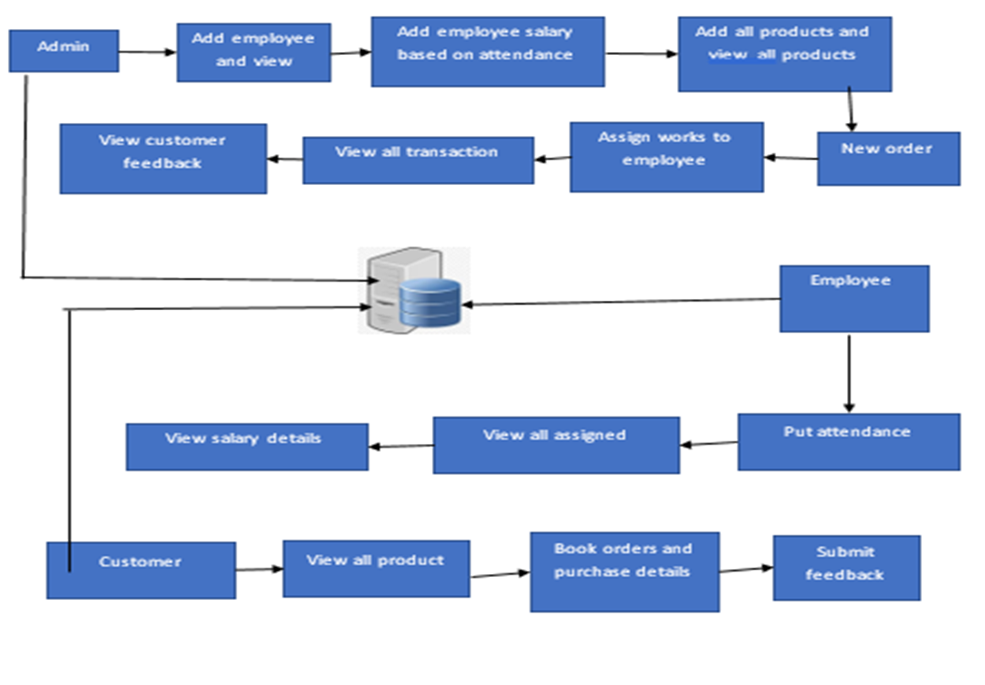
SYSTEM ARCHITECTURE

Slide 9
MODULE- ADMIN
The admin is a key figure responsible for overseeing and controlling various aspects of this website. This role involves:
Login the account with correct user name and the password
Add the employee with the basic information
View all the employee
-->If we don’t want this employee means delete, If we need made some changes means edit, and make enable means view.
Add employee salary
-->view all the employee and update the salary amount for the particular employee
Add the product
--> Add the product with the full details
View all the Machinery items
-->If we dont't want this product means delete, If we need made some changes means edit, and make enable means view.
New orders by the customer
--> View all the new orders and assign the works to delivery boy
View all the assign work status
Logout.

Slide 10
MODULE-EMPLOYEE/DELIVERY BOY
In this website, an employee contributes by:
Login the account with correct username and the password
View their Own Profile
Put the attendance details
View all the salary details.
View all assigned works and uploaded status by the admin
Logout

Slide 11
MODULE-CUSTOMER
In this website, a customer contributes by:
Register the account with basic information
Login the account with the correct user’s name and password
View their own profile
View the menu of products available in the Machinery store, add to cart and
-->if you want choose online payment means, enter your bank details and the Cash on Delivery
View all the order status
View all your transaction detail. Once you get that products means it is visible.
Logout

Slide 12



DESCRIPTION
Client Layer (Front-End)
User Interface (UI): This is where users interact with the website. It includes:
Homepage: Showcases key information and features.
Product Pages: Detailed information about machines, specifications, and images.
Service Pages: Information about maintenance, support, and other services.
Contact Forms: Allows users to get in touch with the company.
Login/Signup Pages: For customer accounts and personalized services.
Search Functionality: To help users find specific machines or services.

Slide 13
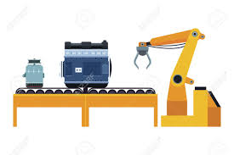
Application Layer (Back-End)
Web Server: Handles incoming HTTP requests and serves the website’s pages.
Server-side Logic: Manages business logic, processes user requests, and interacts with databases.
API Endpoints: Provides data to the front-end and handles communication between the client and server.

Slide 14
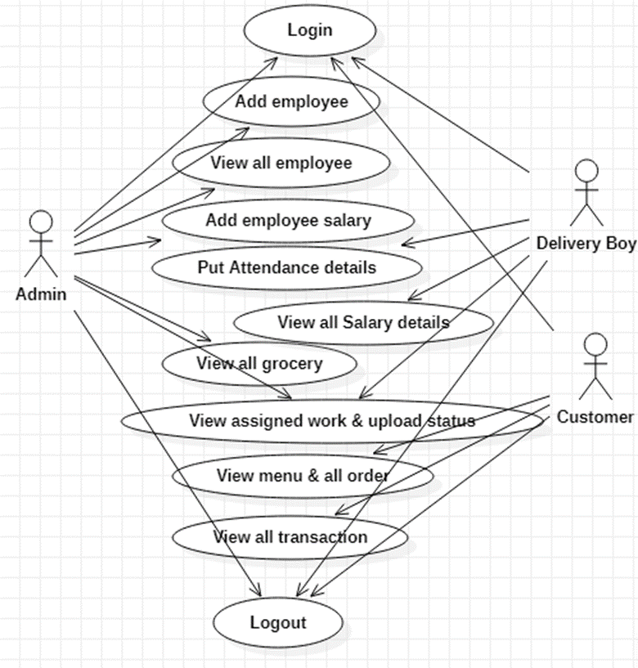
USE CASE DIAGRAM
A use case diagram is a visual representation of how users interact with a system to achieve specific goals. It helps in identifying and organizing the functional requirements of a system by outlining the interactions between users and the system.

Slide 15
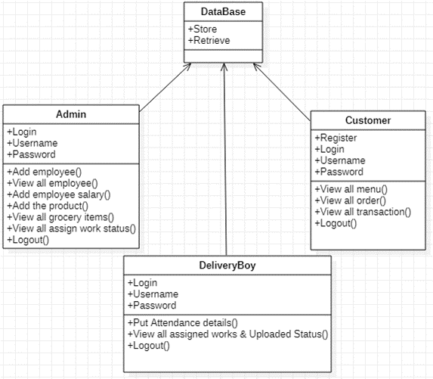
CLASS DIAGRAM
A class diagram is a type of static structure diagram used in object-oriented modeling to represent the structure of a system. It shows the system's classes, their attributes, methods, and the relationships between them. Class diagrams are essential for designing and understanding the architecture of a system.

Slide 16
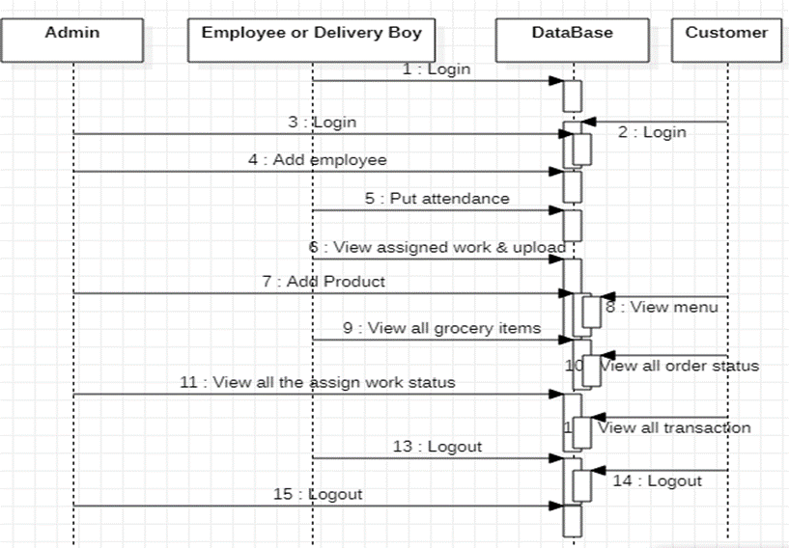
SEQUENCE DIAGRAM
A sequence diagram is a type of interaction diagram that shows how objects or components in a system interact with each other over time. It is used to detail the sequence of messages exchanged between these objects to achieve a specific goal or behavior.

Slide 17
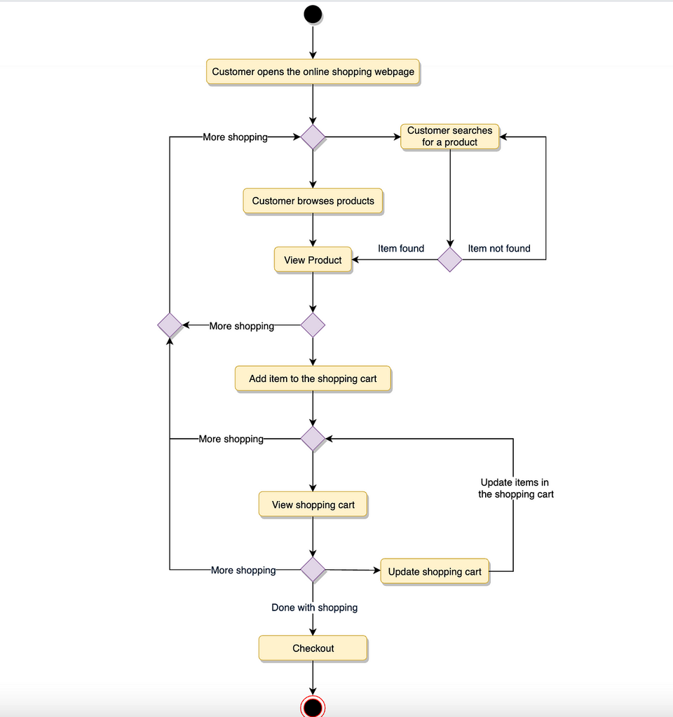
ACTIVITY DIAGRAM
An activity diagram is a type of behavioral diagram that represents the flow of activities or actions in a system or process. It is used to model the dynamic aspects of a system, such as workflows, business processes, and the sequence of actions or steps involved in completing a task.

Slide 18
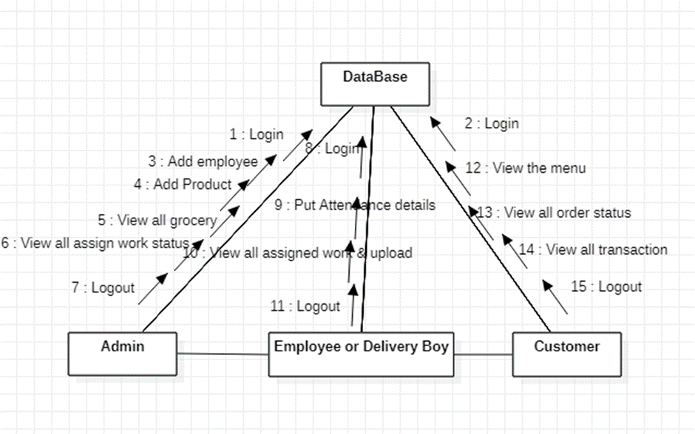
COMMUNICATION DIAGRAM
A Communication Diagram is a type of interaction diagram that illustrates the interactions between objects or parts of a system and how these interactions collaborate to achieve a specific behavior or outcome.

Slide 19
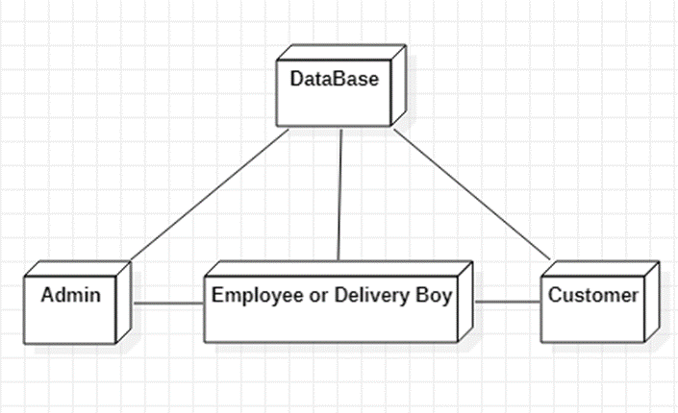
DEPLOYMENT DIAGRAM
A Deployment Diagram is a type of structural diagram that visualizes the physical deployment of artifacts on nodes (physical hardware or computational resources). It shows how software components are distributed across hardware and how they interact with each other within a system's infrastructure.

Slide 20
CONCLUSION
The development of the software includes so many people like user system developer, user of the system and the management, It is important to identify the system requirements by properly collecting required data to interact with the system.
Proper design builds upon this foundation give a blue print, which is actually implemented by the developers. On realizing the importance of the systematic documentation all the processes are implemented using a software engineering approach.
Working in a live environment enables one to appreciate the intricacies involved in the System Development Life Cycle (SDLC)).
In one place we can get Everything for the Customer comfort.

Slide 21
THANK YOU!

